Slide 1

WeSchool Library Services
March 2017
Dr. Sandeep Bhavsar
Librarian
M.Lib.I.Sc, MAH-SET, American Library Association FERA 2011 fellow, Ph.D

Slide 2
Index
Library Management Software – Koha
Online Book Suggestion for Library
WebOPAC & Online Chat
Institutional Repository – Dspace
Open Journal System (OJS)
Databases Training/User Orientation
Remote access to online resources
One Stop Shop – InfoWe
LRC Blog
Infocapsule
News of the Day
Periodicals New Arrivals
New Arrivals of Books
Thought Leadership
Book Review & Weschool in Media
Industry Update for Weschool Alumni
Research/Project Support
Must Read Articles
New Arrivals Display
Thematic Display
Audio-Visual Room
Events

Slide 3
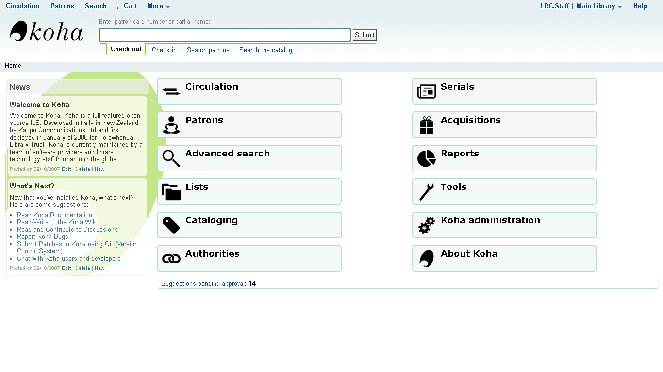
Koha - Library Management Software
KOHA – Library automation software is used extensively with all the modules being functional.
TOP

Slide 4
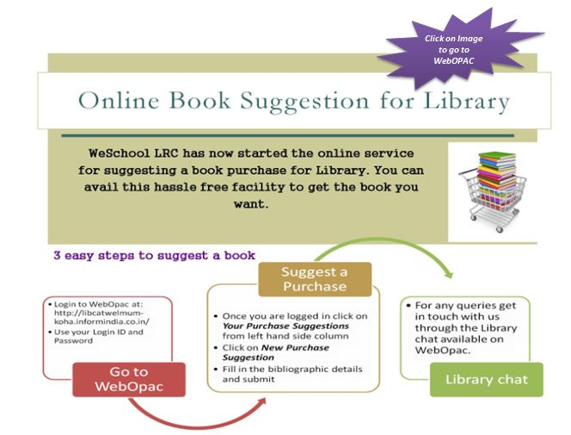
Online Book Suggestion for Library
TOP

Slide 5
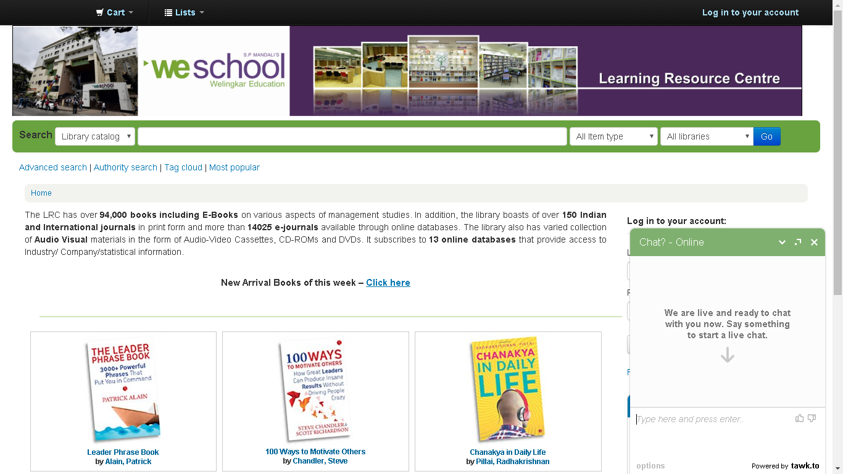
WebOpac
WebOpac acts as a single interface for all the library collection. Users can also access the catalogue remotely. WeSchool also provides Online Chat service for all reference queries.
Link: http://libcatwelmum-koha.informindia.co.in/
TOP

Slide 6
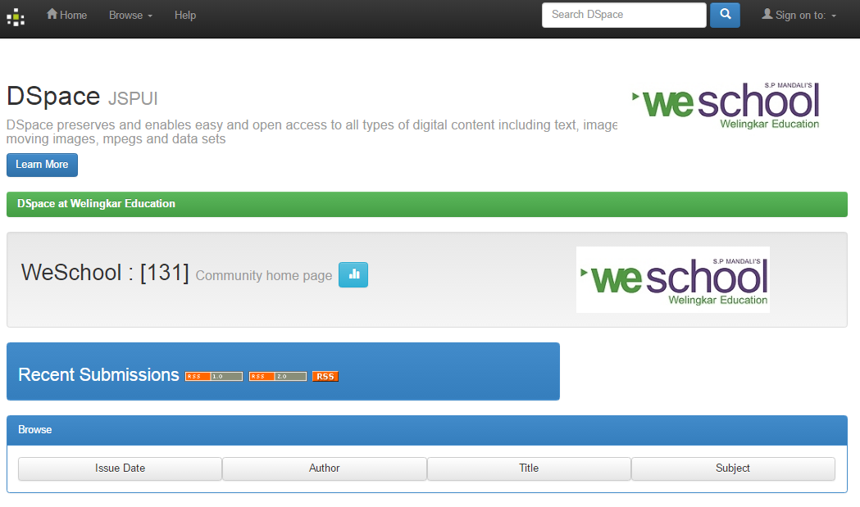
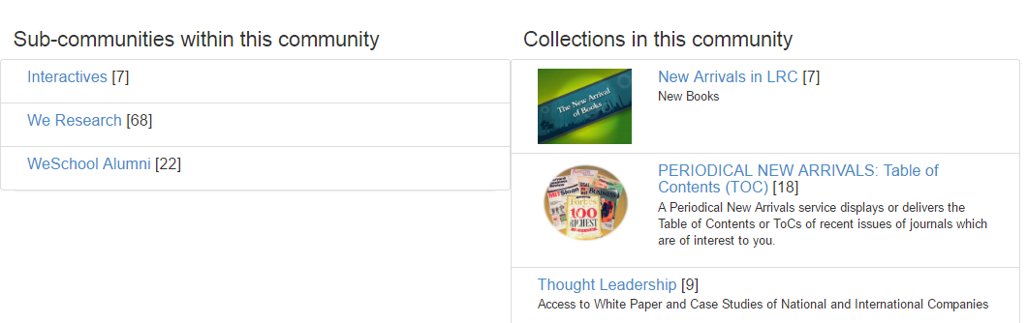
DSpace – Institutional Repository Application
LRC has developed an Institutional Repository using D-Space which gives access to research and academic output. Currently this contains over 200 articles by faculty members of WeSchool published in national and international journals and our own research publication called aWEshkar.
Link: http://dspace.welingkar.org:8080/jspui/
TOP

Slide 7
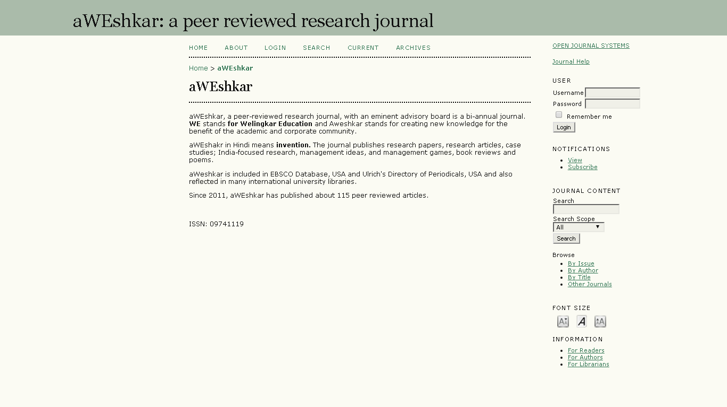
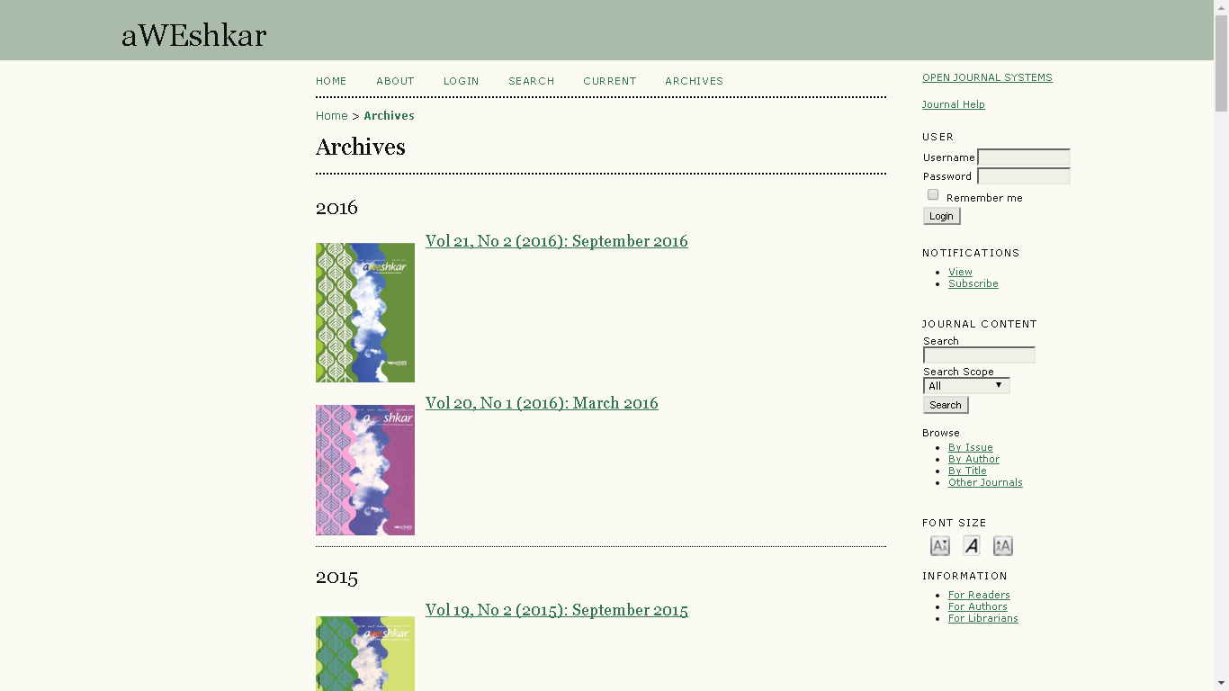
Open Journal Systems (OJS)
OJS is open source software made freely available to journals worldwide for the purpose of making open access publishing a viable option for more journals, as open access can increase a journal’s readership as well as its contribution to the public good on a global scale . Issues from 2001 of Welingkar’s in-house Journal “aWEshkar” are published online through OJS.
Link: http://elibrary.welingkar.org:2172/ojs/index.php/aWE/issue/archive
TOP

Slide 8

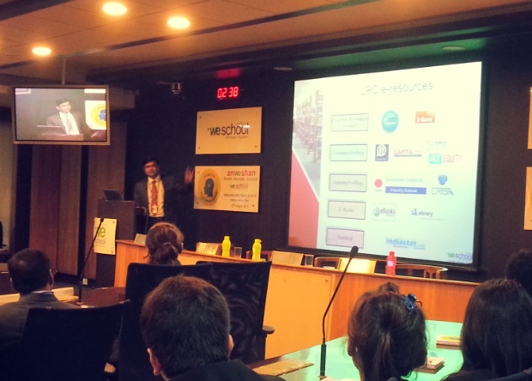
Database Training/User Orientations
WeSchool LRC organizes Database Training – Hands on Experience to WeSchoolites every year to make the students well versed with databases of the library. Welingkar has subscribed to 13 high quality databases for the WeSchool students and faculties. External trainers from respective databases are called for training students.
Database Video Tutorials: http://dspace.welingkar.org:8080/jspui/handle/1/13
WeSchool LRC also conducts user orientation sessions to take the new students and faculty through the LRC journey. We also conduct Databases and Career Development sessions
TOP

Slide 9
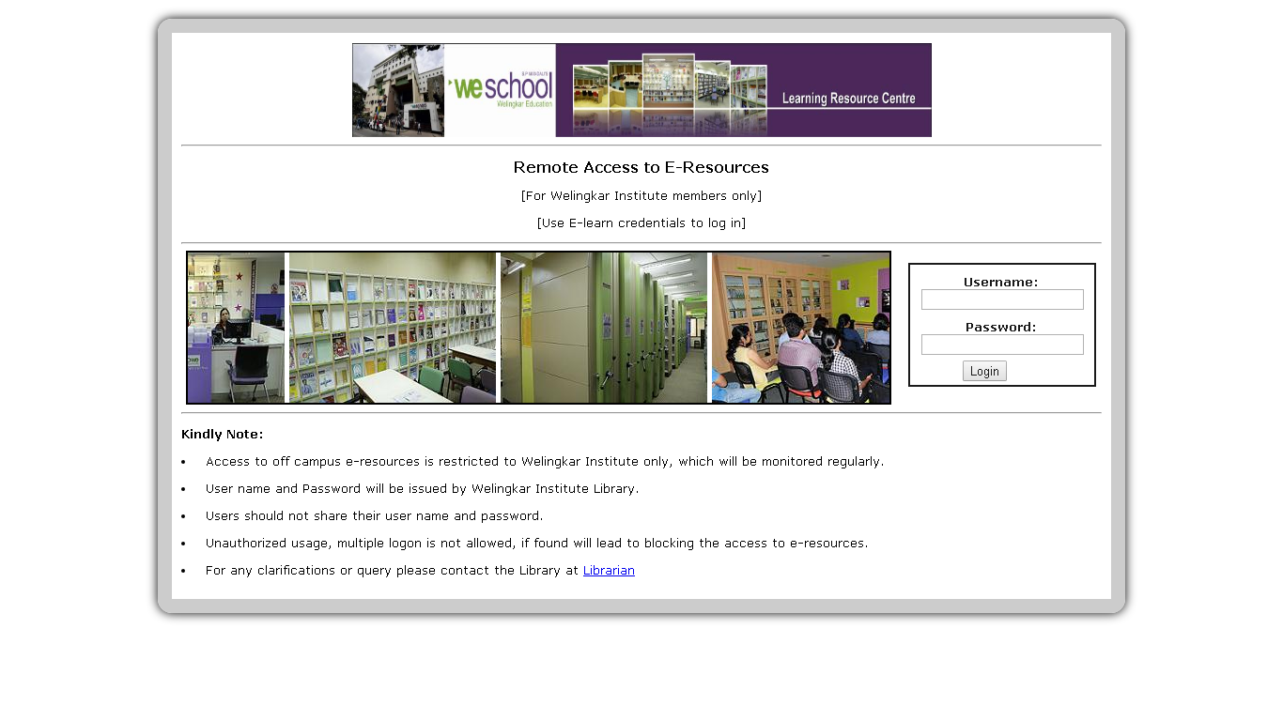
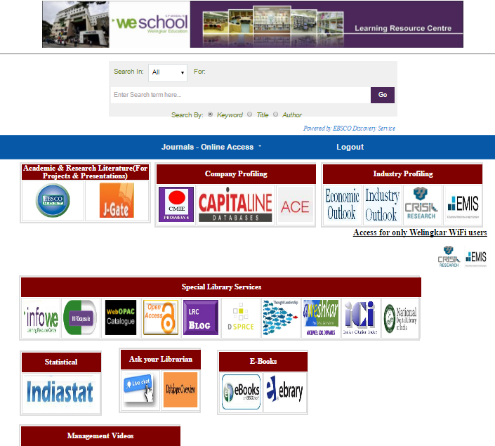
Remote Access
WeSchool students and faculty can access e-resources and databases off campus through EZproxy. EBSCO Discovery Service provides libraries with a powerful discovery layer providing a unified index of a library's resources and a single search experience.
Link: elibrary.welingkar.org:2048/login
TOP

Slide 10
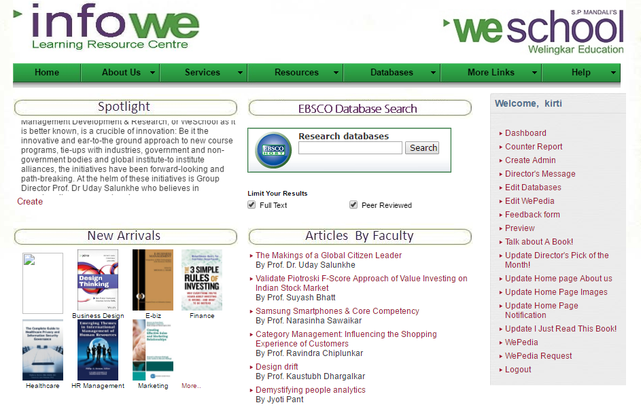

Infowe – One Stop Shop for
Info Needs of the weschoolers
Link: elearn.welingkar.org/infowe
TOP

Slide 11
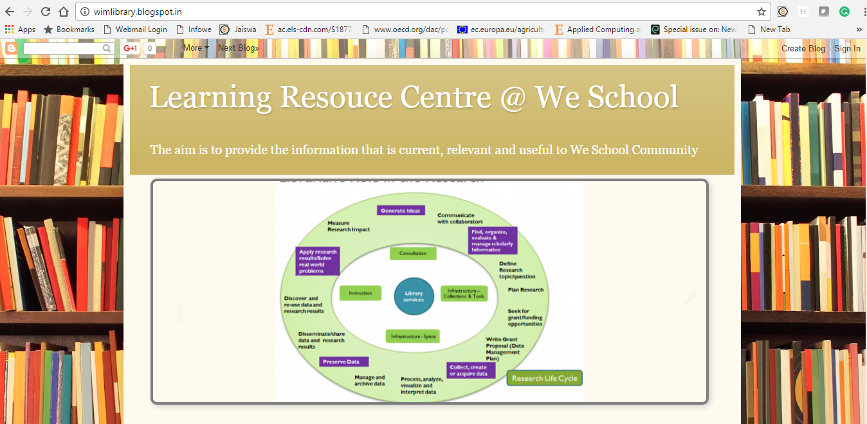
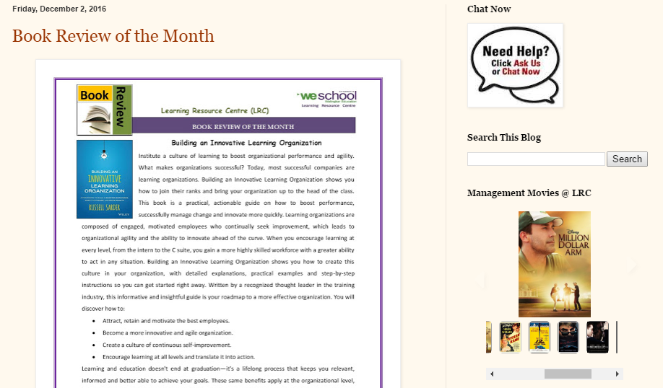
LRC Blog
Link: wimlibrary.blogspot.in
TOP

Slide 12
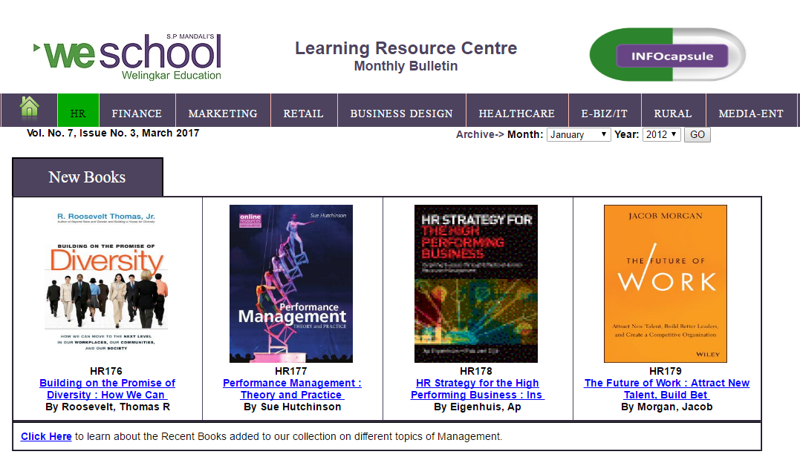
INFOcapsule
INFOcapsule - bulletins on HR, Marketing, Finance, Retail, Business Design, Healthcare ,E-Biz - IT, Rural, and Media Entertainment. Captures e-books, articles, news and videos.
Link: https://elearn.welingkar.org/infowe/Infocapsule/
TOP

Slide 13
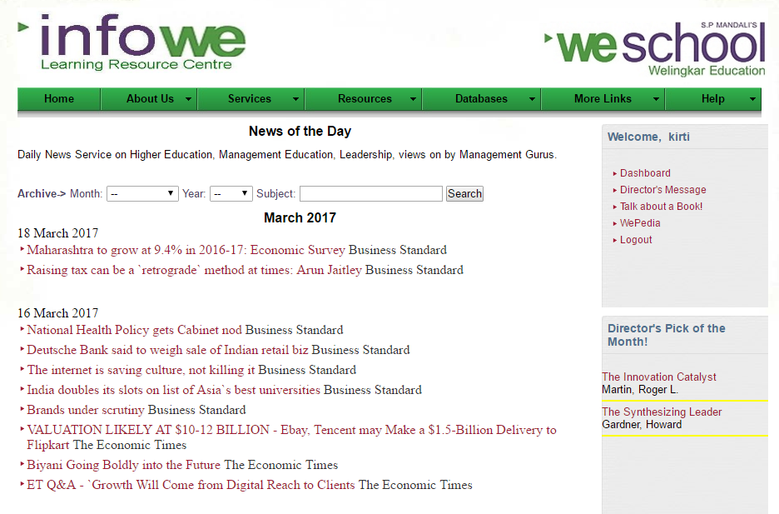
News of the Day
Daily News Service is provided wherein various subject are covered such as marketing, e-commerce, higher education, management etc. from assorted newspapers such as Business Standard, The Financial Express, Economic Times etc.
TOP

Slide 14

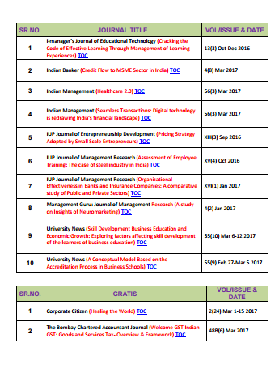
Periodical New Arrivals
WeSchool LRC subscribes to about 150 print journals and more than 5000 full-text online journals. To ensure our faculty and students will always be up-to-date with the latest research trends, electronic table of contents services are provided to all WeSchoolers.
TOP

Slide 15
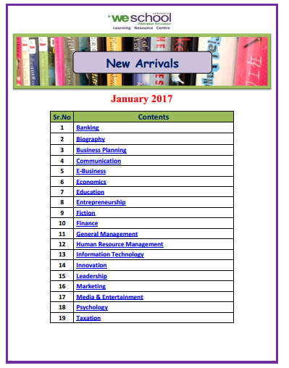
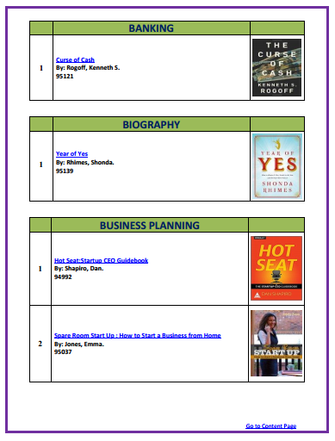
New Arrival of Books
The monthly New Arrival of Books service is a list of the newly added books in the library collection for that particular month. It is a subject wise list of new arrivals. The titles are linked to the Catalogue (WebOPAC) wherein the user can check the availability of the book.
TOP

Slide 16
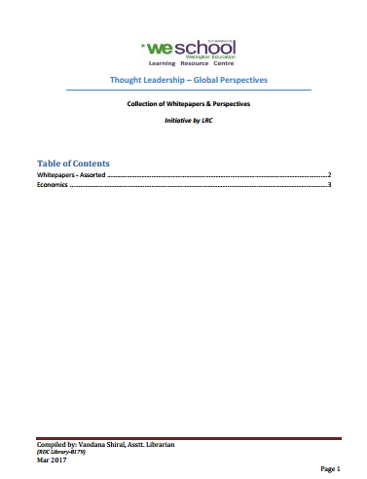
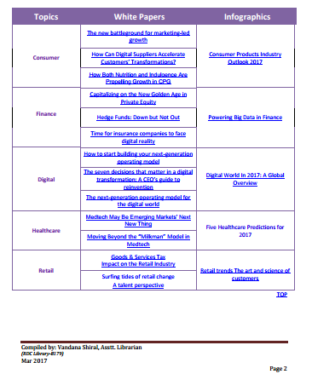
Thought Leadership
The Monthly ‘Thought Leadership–Global Perspectives” service renders information about the latest management trends and endeavour to collate the thought leadership across different verticals and regions. Even infographics are included for reference.
TOP

Slide 17

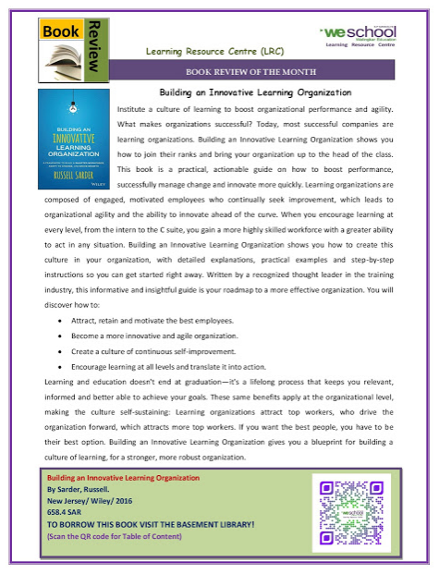
Book Review and WeSchool in Media
Every month “Book Review” service is provided for a selected management books and displayed on the notice board and LRC Blog. WeSchool provides a service called “WeSchool in Media” wherein links to newspaper articles are provided whenever WeSchool appears in the news or media for a predetermined period.
TOP

Slide 18
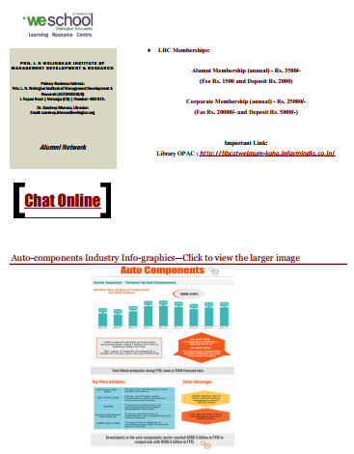
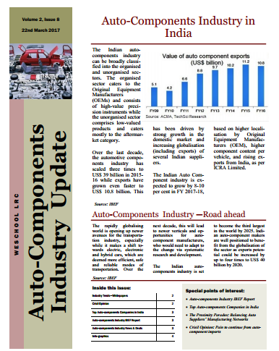
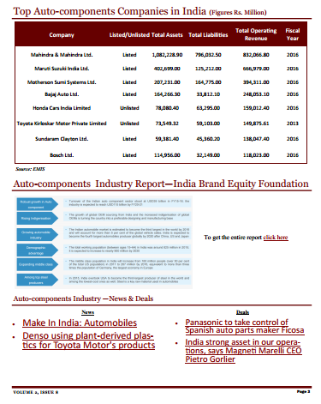
Industry Update for Weschool Alumni
Exclusive service to Weschool Alumni to keep them posted about the up comings in different sector/industries. The service is provided on weekly basis.
TOP

Slide 19
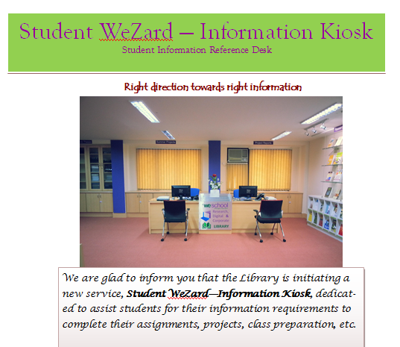
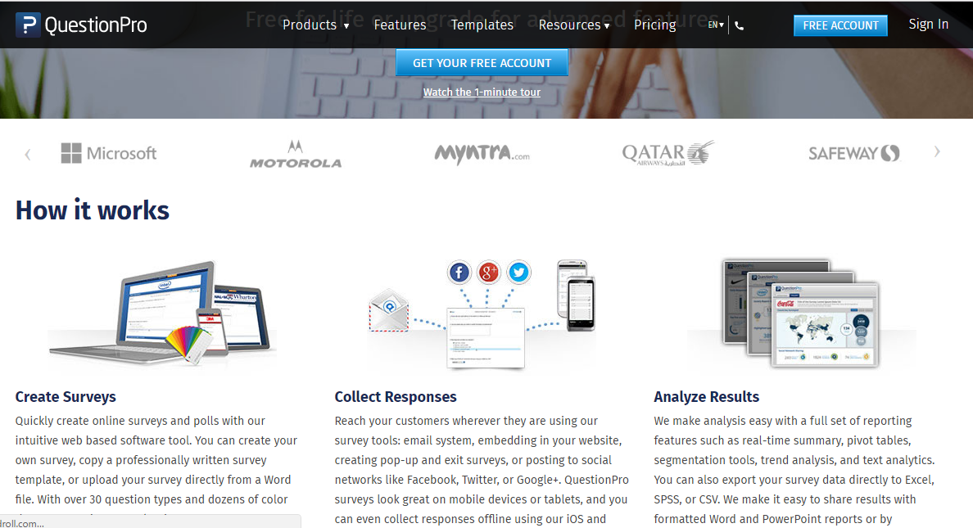
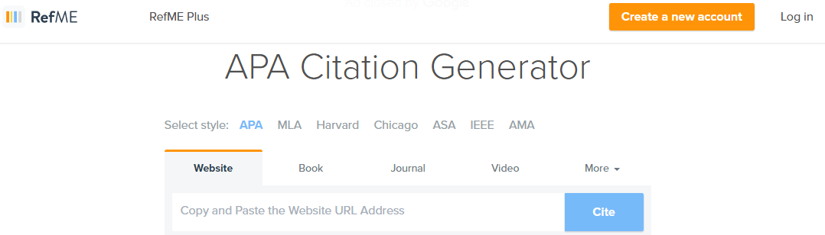

Research/Project Support
We have started an exclusive service for the students wherein we will be providing the reference services specific to their curriculum and projects. A dedicated resource person will be available for the same.
QuestionPro -Online Survey Tool
Anti-plagiarism software
TOP

Slide 20

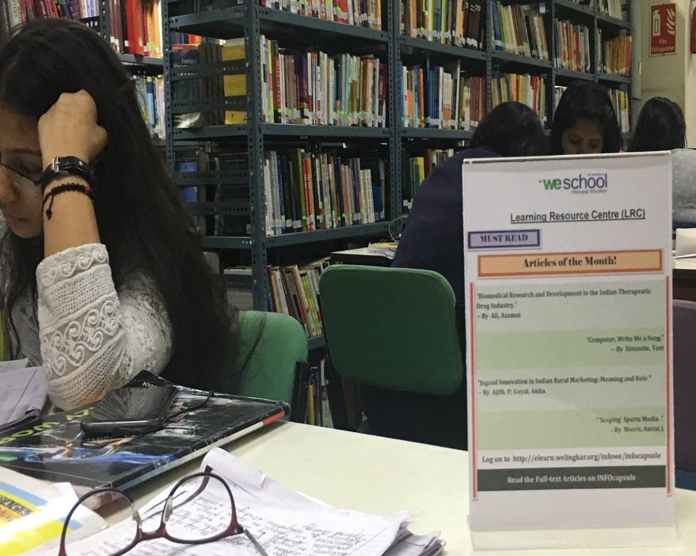
Must Read Articles
“Must Read Articles of the Month” is a monthly service wherein the articles of most importance are highlighted and displayed in the reading hall. The Full-text Articles are available on INFOcapsule.
TOP

Slide 21
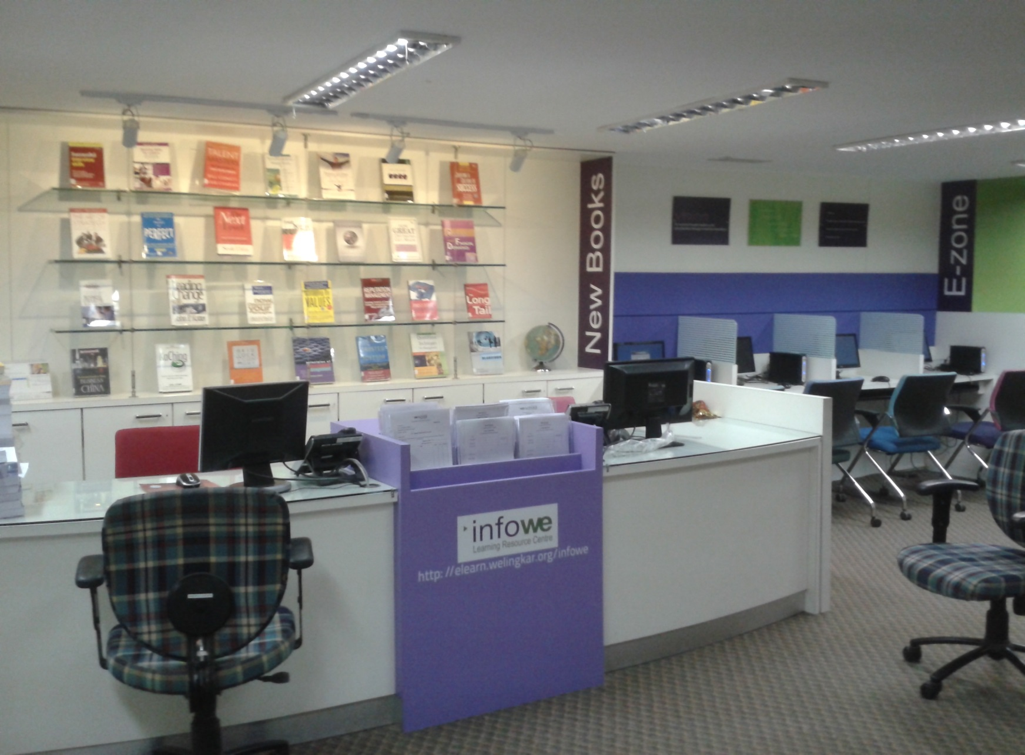
New Arrival Display
TOP

Slide 22
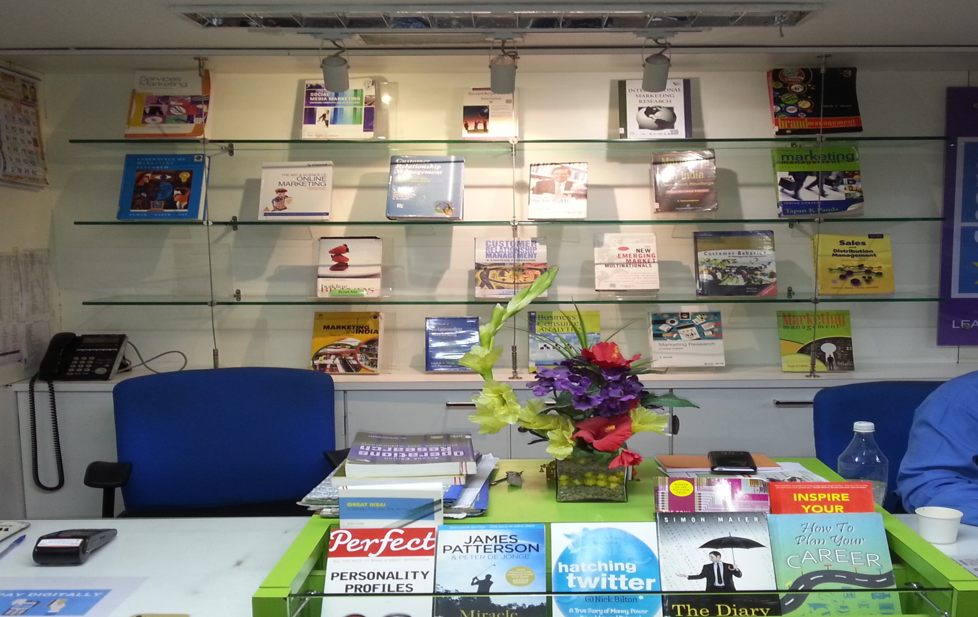
Thematic Display
A Disply Theme is decided upon every month and the books are displayed accordingly.
TOP

Slide 23
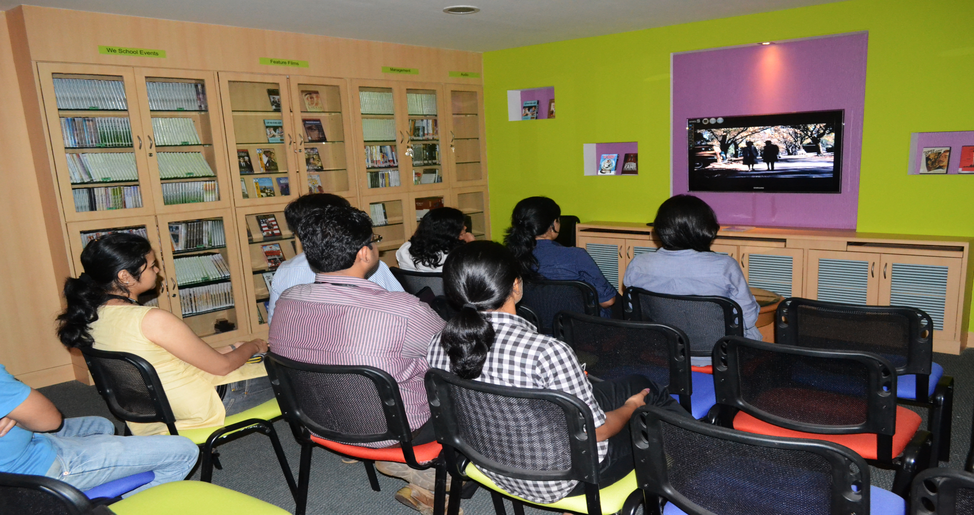
Audio/Visual Room
A/V Room is used by students and faculty for screening of Business and Management Videos/movies. We have a huge collection of management movies.
TOP

Slide 24
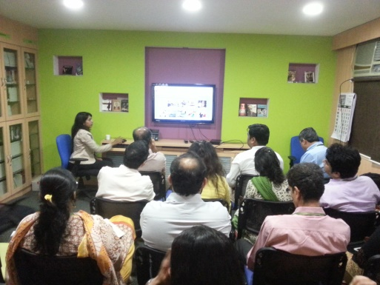
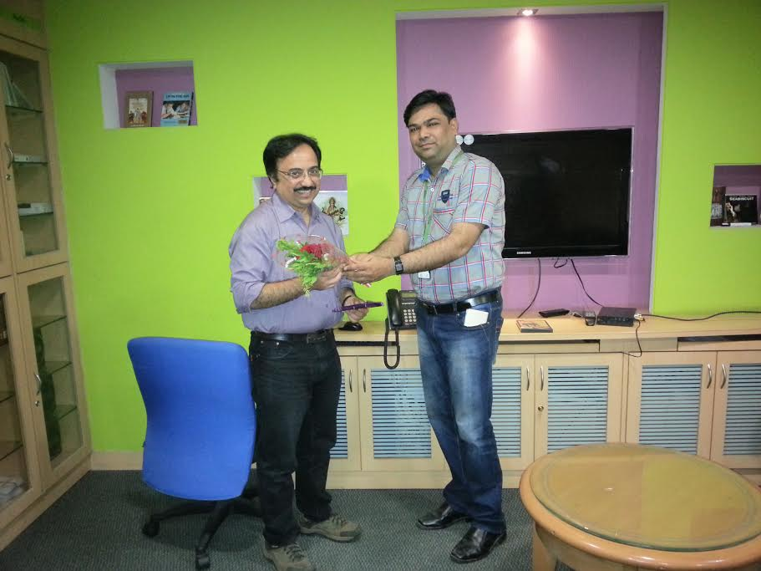
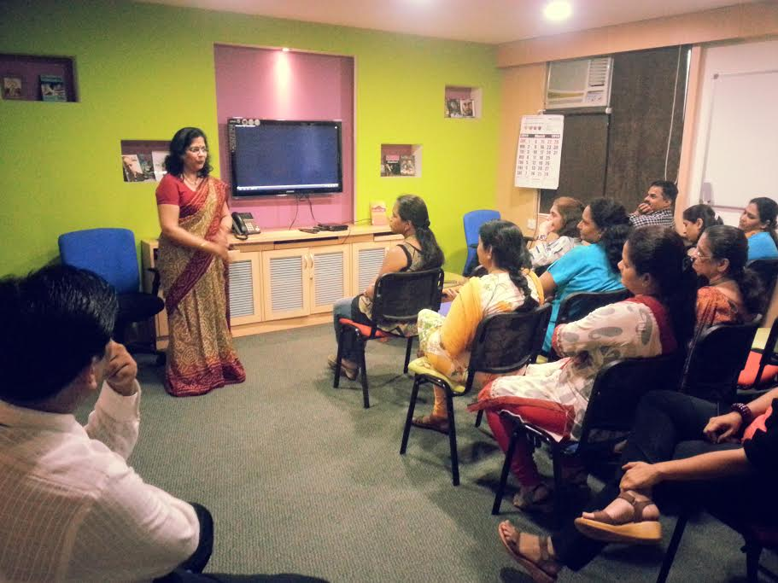
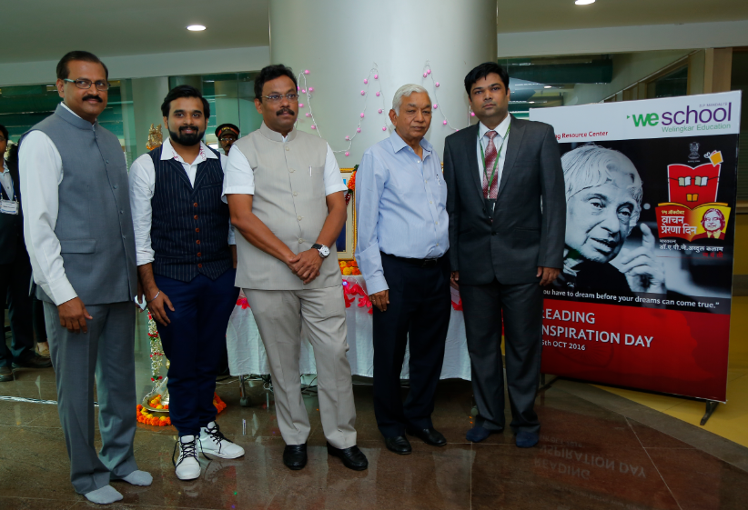
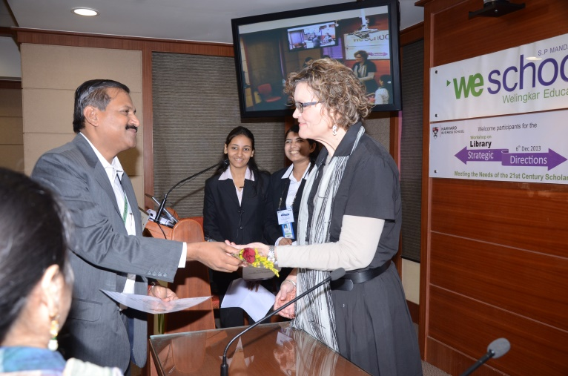
Events
QuestionPro Session
Best Library Patron
Yoga Day Lecture
Vachan Prerna Divas
HBS Workshop
TOP

Slide 25
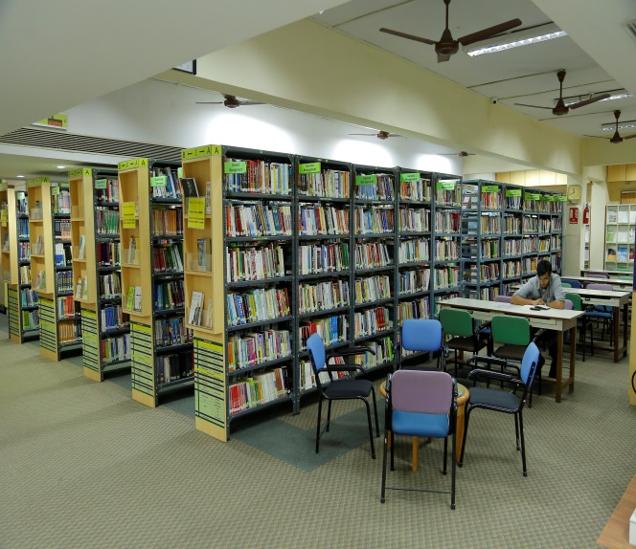
Thank You & welcome to the world of knowledge

